Slide 1

SPACE SETTLEMENT DESIGN COMPETITION
By: FRESHMAN CLASS OF 2020

Slide 2
CASSANDRA
START YOUR JOURNEY ON…
“ADVENTURE AWAITS”

Slide 3
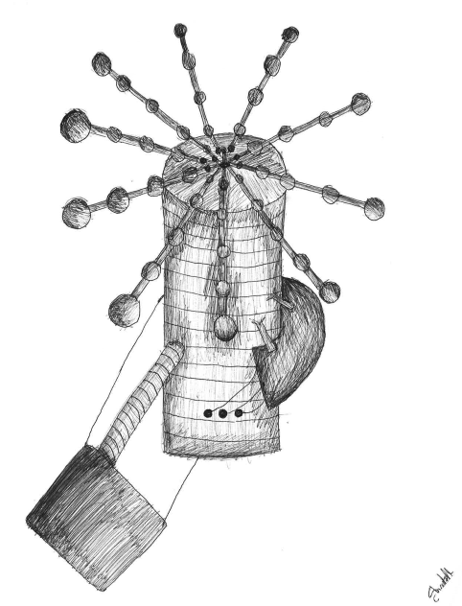
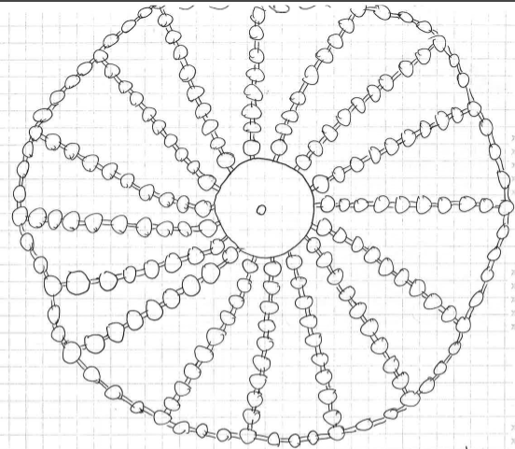
Outside of spaceship

Slide 4
How to get on spaceship?
Enter in a lottery
Winners will get to board the spaceship
Once on spaceship pay for housing, housing services and Wi-Fi
1-2 people housing $1,000
1-4 people housing $2,000
2-6 people housing $5,000
4-10 people housing $10,000
We will be allowing 2,300 people full time.

Slide 5
Coordinates for space settlement station
  117° North, 36° West
  It is close enough to Earth so that people can get there easily and quickly
  It is out of the Earth’s gravity

Slide 6
Air Sealed Doors
Need key fob for access through the doors or another option is an eye scanner.
5 different doors:
  1st door connects to the inside of the ship.
  2nd door is a hallway to any mechanical equipment
  3rd door leads to outside shuttle-pad for main entrance.
  4th door leads to emergency and service vehicle garage.
  5th door leads to robot house/maintain.

Slide 7
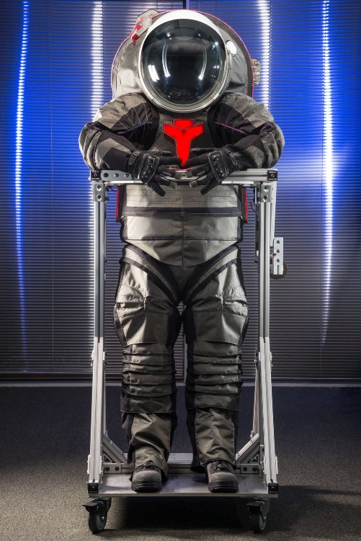
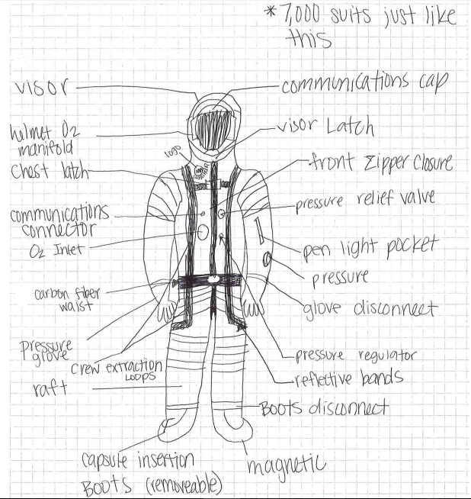
Space Suites

Slide 8
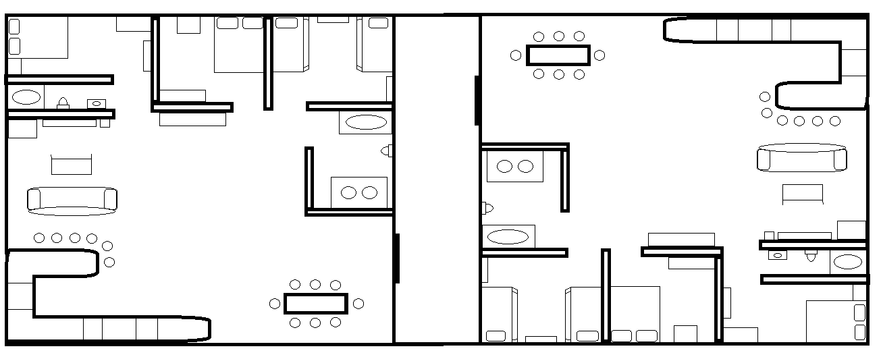
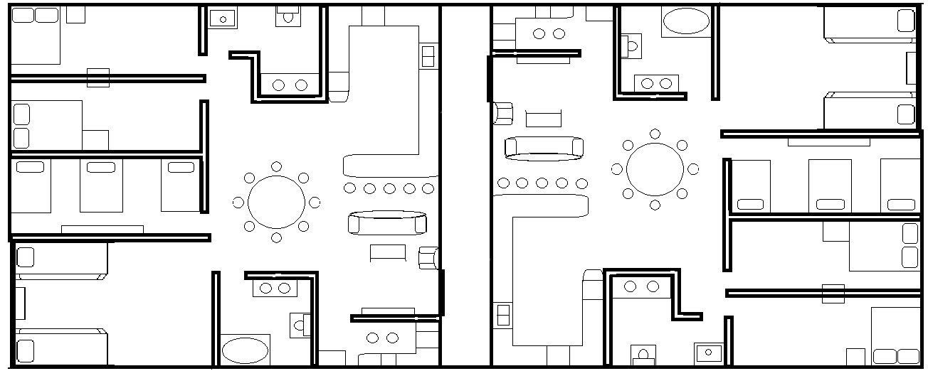
Living Cells
  They get smaller for the amount of people there are per room.
  The biggest cell can hold up to 10 people
  The smallest can hold up to 2

Slide 9
Day/Night Cycles
The lights will be turned on during the day and will be dimmed when night falls.
The amount time the lights are on and off will depend on the season we are in.
City curfew will be at 11:30 for 18 and under.

Slide 10
School
College
  Fairly small
  Like a community college
    About 2-2,500 students
High School
  Size of Central Lyon
  Teachers teach multiple classes
    1,000-1,500 students
Middle School/Grade School
  Size of Central Lyon
  Normal level of teaching
    500-1,000

Slide 11
Jobs and Working
Permanent residents get the choice to have higher class jobs as medical, engineering, teaching, and culinary jobs.
Temporary residents will be left with the lower-class jobs such as shop workers.
Salary will be in Wrights.

Slide 12
Religion Services
We will have one main building to hold all of the religious services in. There will be a different religious service every day.
  Sunday- Protestant and Catholic
  Monday- Judaism
  Tuesday- Hinduism
  Wednesday- Islam
  Thursday- Buddhism
  Friday- Sikhism
  Saturday- Shinto

Slide 13
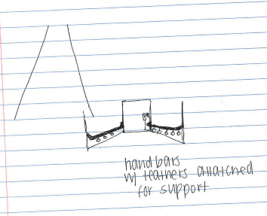
Safety
  When you are not located in a pressurized room you will be required to wear a spacesuit.
  We will have security agents that patrol the settlement non-stop.
  We will also have a fire and rescue team that is always ready.
  In case of emergency dial 199.

Slide 14
Health
  We will have a state of the art hospital with a maximum capacity of 2,500 people.
  We will have robotic ambulances that are programmed to know where to go when they are called.
  We will have multiple pharmacies located throughout the settlement, so your drugs are easily accessible.

Slide 15
Transportation
Trolley system throughout the space craft.
Every room will come with a Segway.
Bikes, scooters, roller blades, and pogo sticks will be encouraged on the ship.

Slide 16
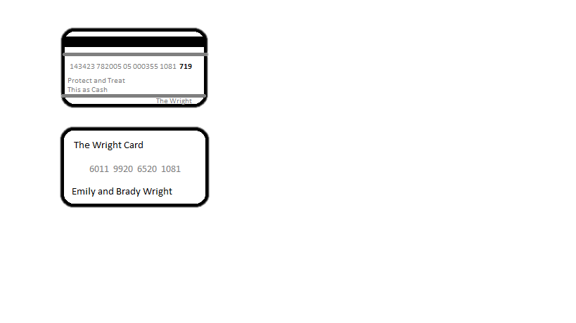
Money
Name of Money: Example:
  Wright
  Currency: Front→
    1 USD = 20 Wrights
    Form of Money:
      All online
      On one card
      Automatically subtracts from your account
      Back→

Slide 17
Water
Purifying
  Filter it through filters
  Boil it
Transporting
  Pipes transport it to bathrooms, kitchens, etc.
  Stored in big tanks
  Use water pressure to move the water

Slide 18

Fuel
Liquid Hydrogen:
  Reasons:
    Lightweight
    Powerful
    Can store a-lot of it.
    Stored at -425° F
    Burns at 5,500° F

Slide 19
Trash and Waste
Waste:
  Fertilizer:
    Reasons:
      Re-useable
      As Little Waste as Possible
      Better for Soil
Trash:
  Burn It:
    Reasons:
      Energy can be Produced
      Little Pollution

Slide 20
Corporations Present on the Settlement
Trump Tower
US Bank
Wells Fargo
AllState Insurance
State Farm Insurance
Law Firm

Slide 21
Restaurants and Stores
Restaurants
Stores
McDonalds
Pizza Hut
Hu Hot
Applebee's
Taco Johns
Subway
Culvers
Olive Garden
Panda Express
Chic Fil’ A
KFC
Qdoba Mexican Grill
Starbucks
Macys
Walmart
Target
Shoe carnival
Old Navy
Scheels
Game stop
PINK
Walgreens
Hyvee
CostCo

Slide 22
Creating and Storing Energy
Creating
  Energy will be created by using solar panels attached to the outside of the settlement.
Storing
    Energy will be stored in a device called an accumulator.

Slide 23
Communications
External
Internal
Social media will be present on the space craft so we will be able to communicate with Earth and Mars.
Satellites will be used.
Wi-Fi is available.
Intercoms in each room with built in sound systems.
Both audio and video messaging.
Elevator music is played throughout the day in the hall until the Captain has a message.

Slide 24
Entertainment
We will have a multi-purpose arena with many forms entertainment surrounding the arena.
These places of entertainment are
  A theater
  Gyms
  Playground
  Arcade
  Pool/waterpark
  Bowling alley
  Rollerblading rink
  Skate Park
  Gravity simulator

Slide 25
AGRICULTURE

Slide 26
Cows
Beef
  One barn for calves, one barn for growing.
  A 1200 lbs. steer with a ½ in fat, and average muscling, will have about 490 lbs. of meat in the freezer.
  We will need about 750 cattle in the spaceship.
4 barns for cows (2 dairy, 2 meat)
  25 workers per place of cow
Dairy
-one calf barn, one milking.
  Milking Parlor
  12 workers
-The average person consumes .06 gallons per day.
-The average cow make 8 gallons per day.
-We would need 100 dairy cattle because the cattle needs to have some lay off time.

Slide 27
Pigs
4 barns
  2 barns for sows (breeding, gestations, and farrowing)
  2 barns for growing/finisher pigs
  12 workers per barn
  Weekends, holidays, and rotating shifts.
  We will need to have about 1,500 pigs in the space ship.
    The average person eat about 45 lbs. of meat/year
    The average sow has 7 to 12 piglets
    We will have to keep some for breeding and then we can send the rest off to slaughter.

Slide 28
Chickens
  3 barns
    One for layers
    One for broilers
  We will need to have artificial light that turns off for 5 hours and then turns on for the rest of the day. You have to make the light gradually go on and gradually go off.
  We need broilers to lay eggs so we should keep about 1,000 back so we can keep getting new broilers to harvest.
  Part of the chick barn will be an incubation chamber to incubate the eggs because it gives us a better chance of producing more eggs.
  14 people per barn

Slide 29
Food Acquisition
All supplies that are factory made will be brought up to the settlement on a shuttle weekly and loaded onto the ship through the loading dock.
Most of the fruits, vegetables, meats, and dairy will be raised right on the ship in the agriculture department.

Slide 30
Expenses
Nuclear reactor- $300 million
Agriculture department- $240 million
Water treatment facility- $173.8 million
Living quarters- $31 million
Multi-purpose arena- $260.1 million
Cafeterias- $888,999
Robots and transportation systems- $160 million
Stores, Restaurants and recreational areas- $175 million
  Total Expense- $1.340 billion

Slide 31
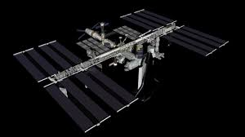
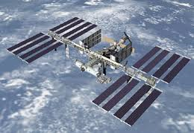
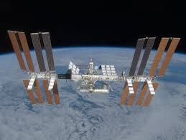
Shuttles

Slide 32
Exhibit Rooms
Scattered throughout Cassandra for observation
Windows made with filtered glass
Windows also throughout Cassandra

Slide 33
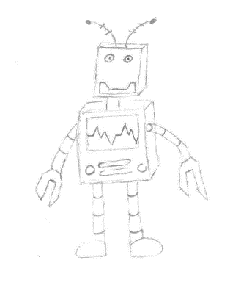
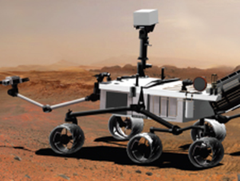
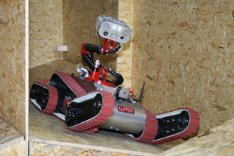
SPACE ROBOTS
  Robots should be no taller than 4 feet
  The use of robots on the Cassandra Spaceship:
  take pictures
  clean apartments
  pick up garbage
  deliver supplies
  loading and unloading cargo
  storing data
  washing clothes
  water out plants
  filing data

Slide 34
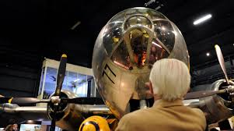
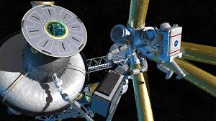
Construction Methods
Made out of carbon fiber composites
Built in space to eliminate conflicts with atmosphere
Piece by piece
60% of Cassandras mass is for human population
30% will constitute propellant
10% equipment associated with the engines.

Slide 35
Artificial Gravity
Def – acceleration resulting from the application of a force.
Ring is attached to the spaceship spins which creates the artificial gravity needed.
Ways to generate artificial gravity:
  Rotation
    A centripetal forced directed towards the center of the turn is required for any object to move in a circular path.
  Linear acceleration
    A spacecraft under constant acceleration in a straight line would give the appearance of a gravitational pull in the direction opposite of the acceleration.
  Magnetism: Basically a magnet with extremely powerful magnetic fields.
  Hypothetical gravity generator

Slide 36
Docking Facility
Hangar inside ship for STS units (space transport systems)
Ships bring in food people and other resources
Put no more than 50 tons total per shuttle visit
3 existing inter-orbital shuttle ships to transfer back and fourth from Earth and Mars
Fueled by He-3
Send out waste and citizens

Slide 37
Thanks for watching!

